Slide 1




Industrial Economics Project
Group A
The Football Industry:
A Global Value Chain Analysis
on the Procurement of Players

Slide 2
The Football Business
World’s Biggest Sport
Football has an estimated number of 3.5 billion fans across the globe, 43% of the population.
Its market size is at least worth $3.1 billion, with a CAGR of 5.82%.
Football clubs have become prominent multinational enterprises, capturing fans from all the diverse socioeconomic backgrounds; nonetheless, its original lower class fan base, still substantially constitutes the nucleus of loyal customers for the business.
The level of personal, social and cultural influence, combined with its scale, has attracted important investments to exploit these opportunities. Now clubs have become much more complex organizations, each potentially pursuing different interests, ranging from the natural opportunities for economies of scope, to the political influence of the Sport.

Slide 3

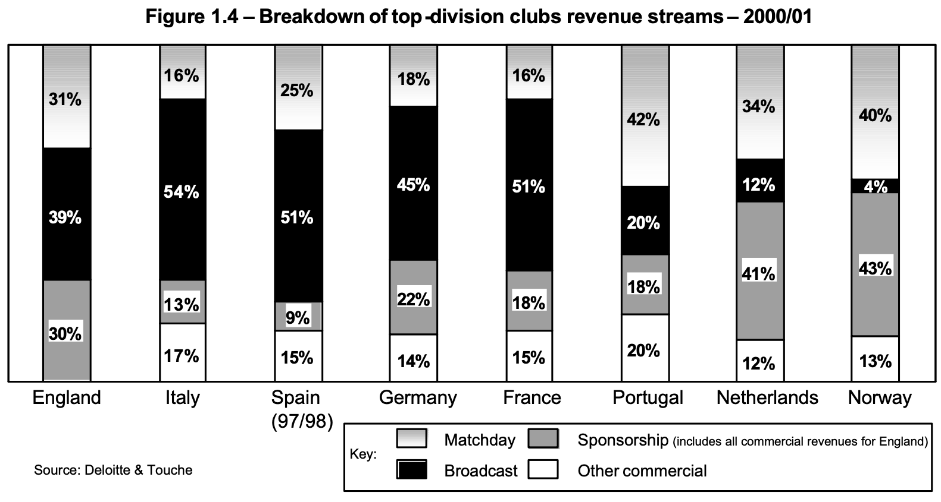



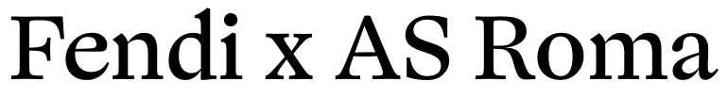
The Football Business
Sources of Revenue
Matchday Services: Food & beverages, Restaurants, VIP programs, tickets etc…
Sponsorships: Main sponsor, Fashion sponsor, Car sponsor etc.
Broadcast: Sky, DAZN, Rai, Mediaset etc..
Other Commercial
Horizontal Integration

Slide 4
The Football Business
Football Club Competition - Value Added Curve
Classic Value-Added Curve
Value Added
Modern Value-Added Curve
Extraction-Transformation
Sporting Team
Marketing & Commodity

Slide 5
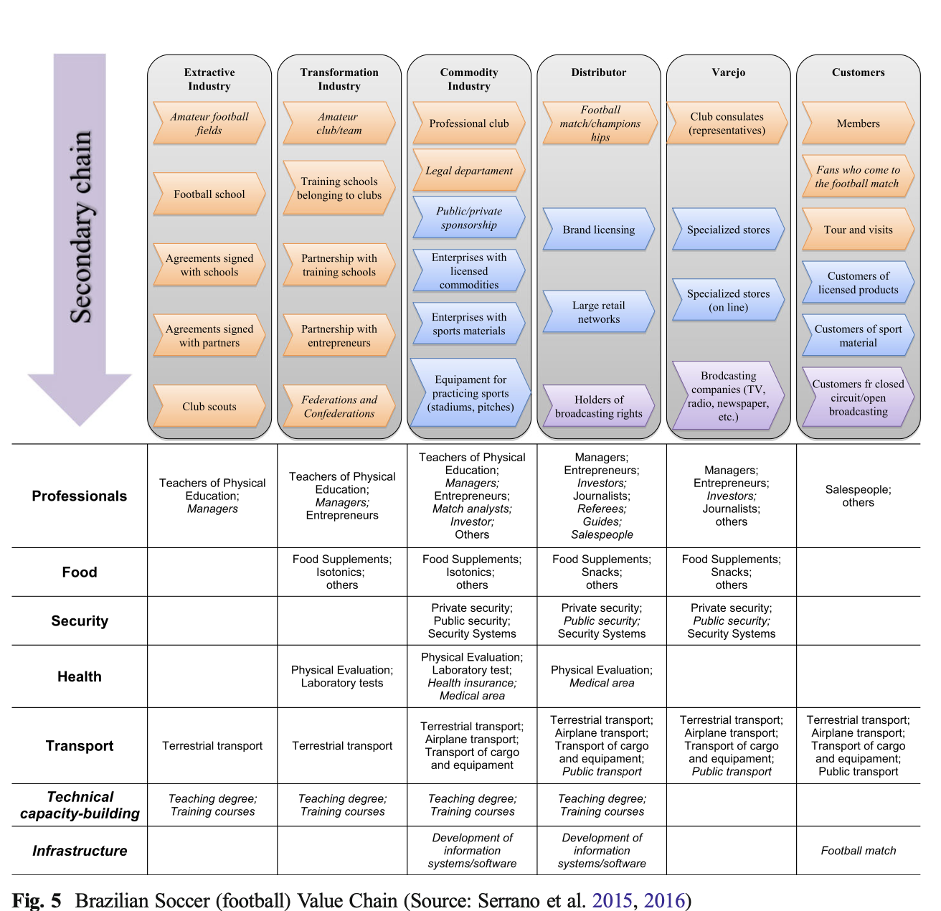
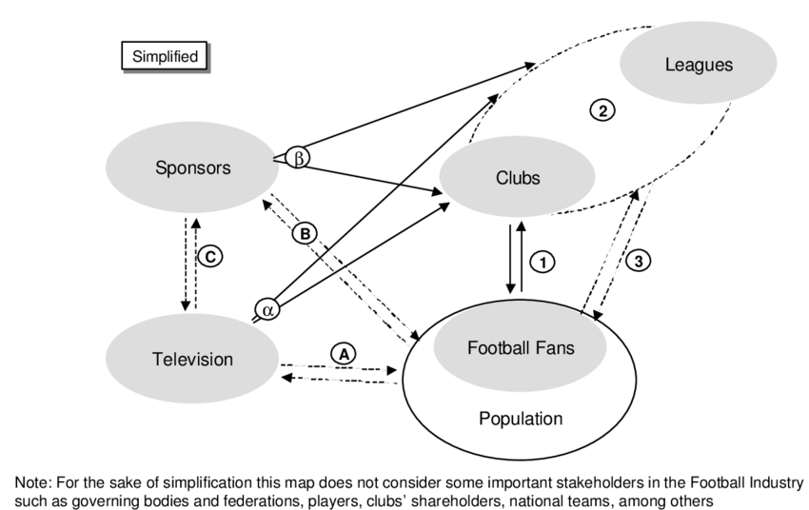
The Football Business
The Complex Global Value Chain - General

Slide 6
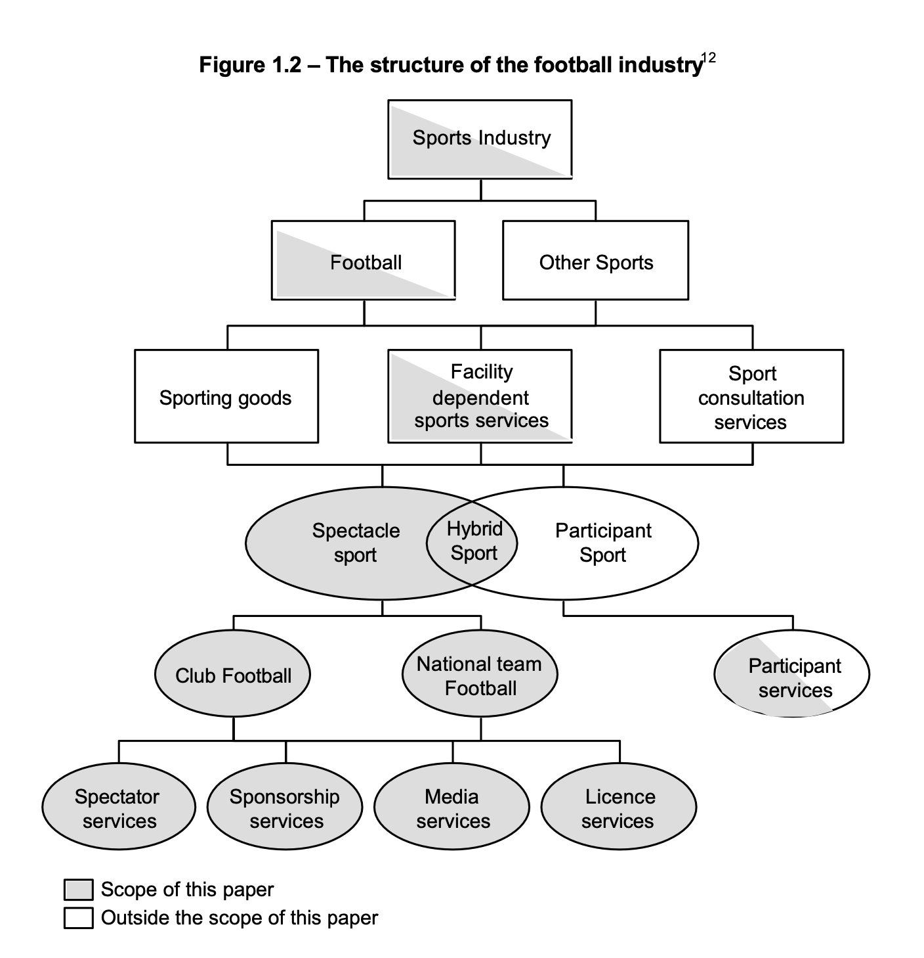
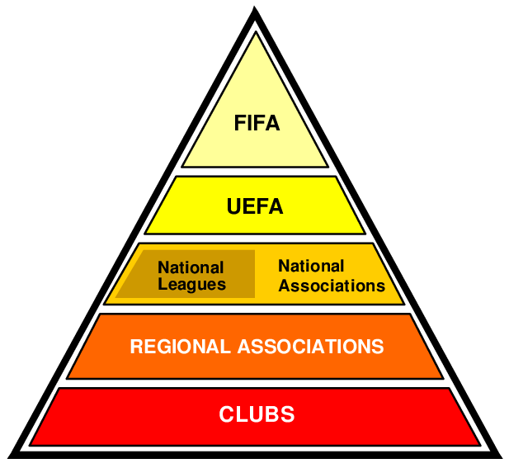
The Football Business
The Complex Global Value Chain – Chosen Topic
MAIN PLAYERS

Slide 7
The Football Business
Football clubs: how do they compete?
Each football team is composed of two parts: The staff, with the manager included, and the Football Team.
We will focus on the Football Team, and, in particular, to the Procurement of Football players.
Therefore, we will now focus on the main two ways you can procure a player, being a Football Club: Youth Academy & Market Transactions.
IMPORTANT: We will consider Football players as Assets. It is a special case, because usually human beings are considered as Labour, and are recognized certain rights. In the Football Industry, Clubs own the Football player: from their performance and for the rights of use of their image. They are booked as assets, and treated as such even economically.

Slide 8
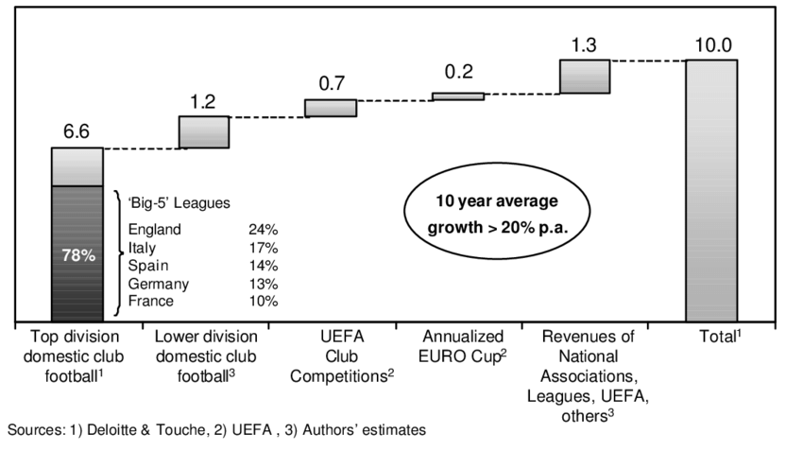
The Football Business
Ways to acquire a new player: a Footballer’s journey
Age 0-11
Age 12-18
Public Administration
&
Investors
Age 19 -
Investors
- The best Academy players go to the first teams
- Kids start playing
- Talent starts emerging
- Sport’s
Promotion & Culture
- Kids train in football schools
- Others get sold or loaned to make experience
- The best get selected for Top Club’s Academy
- The Club sells/buys players every year, during the winter and summer windows
Public Administration
- The others populate lower-level leagues

Slide 9
The Football Business
Ways to acquire a new player: a Footballer’s journey

Slide 10
KEY
The Football Business
Promotion from Academy
Promotion through Agent
Transaction with other clubs
Purchase of Free Agents
Football’s Relational Global Value Chain Governance
2
Club 1
Club 2
Sports Director
3
Sports Director
First Team
First Team
4
Player’s Agent
Player’s Agent
Academy
Staff
Academy
1
Academy
Scouts
PR
Low ability to codify
Target Player
Target Player
High Capabilities
Target Player

Slide 11
The Football Business
Football clubs: how do they compete?
Investments in Youth Academy Transactions and are hard to measure. The cost of players is rather low, the relevant investments in the academy are usually sports facilities and equipment to train young players. These expenses are difficult to retrieve and analyze due to the scarcity of disclosures, since a substantial number of clubs are private. The available invoices are either clearly booked as academy expenses, or, in most cases, it is materially impossible to disentangle the value of the specific investment for the Academy, from the overall value brought to the whole club.
For transaction type , the Agent World is very complex and even harder to analyze. Due to their crucial role in the Global Value Chain, and the rising Agent rents (we will later partially visualize this phenomenon), the biggest international body, Fifa, has tightened the laws ruling the Agent capabilities.
1
2
4

Slide 12
The Football Business
Data Analysis Introduction: Type
3
Object of research:
Is nearshoring increasing or decreasing over-time?
What is the relationship between the leagues of different countries?
What were the effects of COVID–19?
Methodology:
Used open-sourced platforms for the Players Datasets and the Transfers Dataset
Processed data to produce graphs and regressions
Coded in Python, we used an Object Oriented approach to store data, to render our analysis easily replicable. Click here to access the full GitHub Repository of the project.

Slide 13


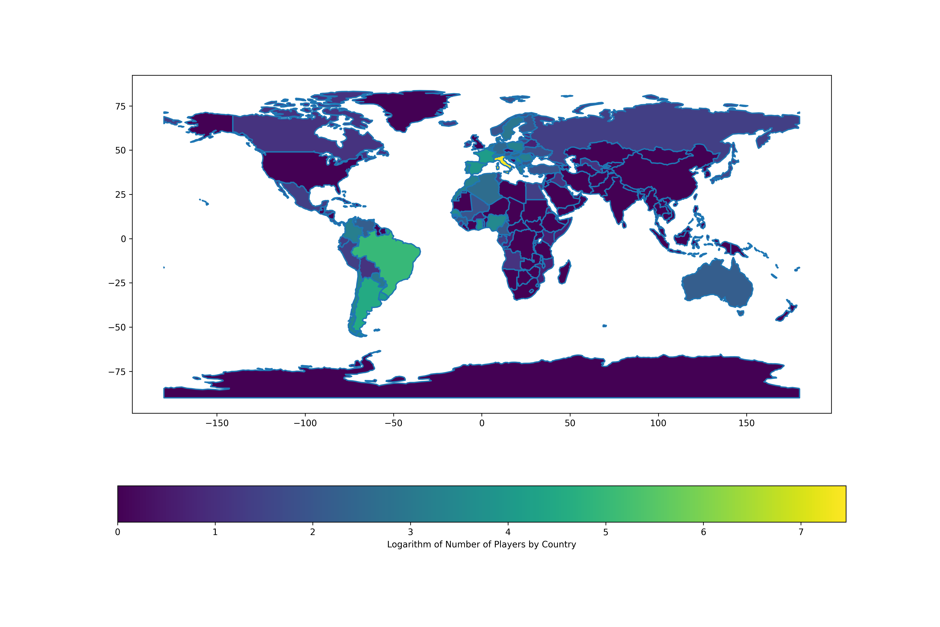


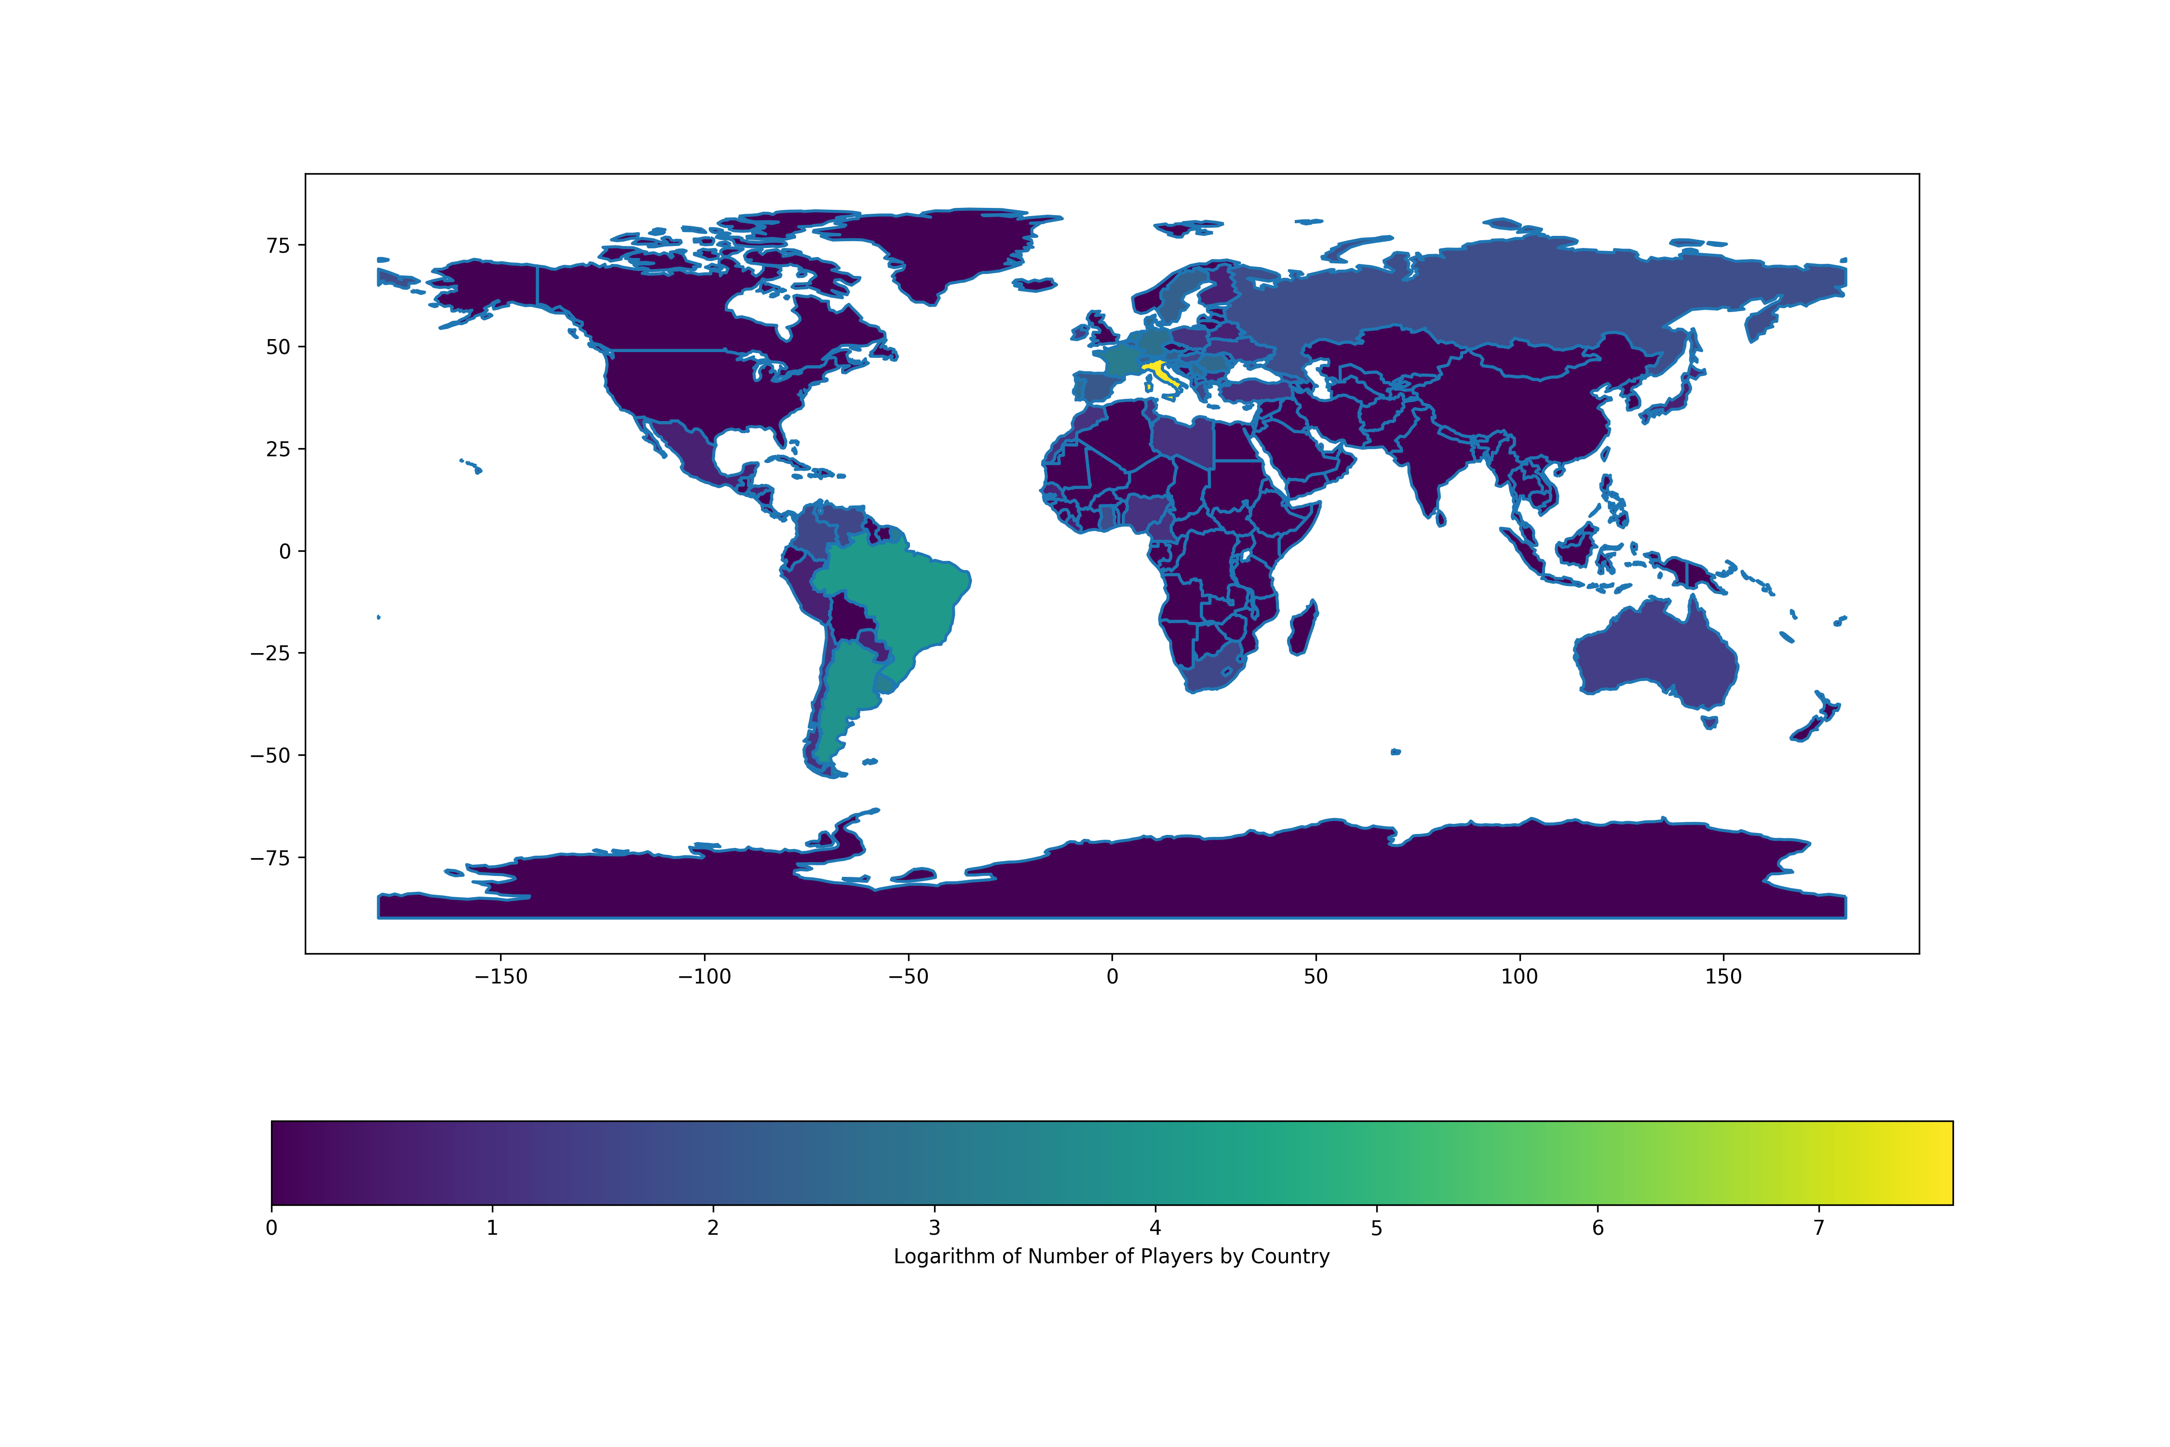
The Football Business
A «Natural» Nearshoring
1978-2002
1954-1978
1930-1954
1906-1930
1858-1882
1882-1906
Football has always been the
People’s sport, and therefore
there has always been
an excess of supply.
Here a slideshow of the
log density of Serie A players
born in each era.
Is the trend changing? Will there be more offshoring?

Slide 14
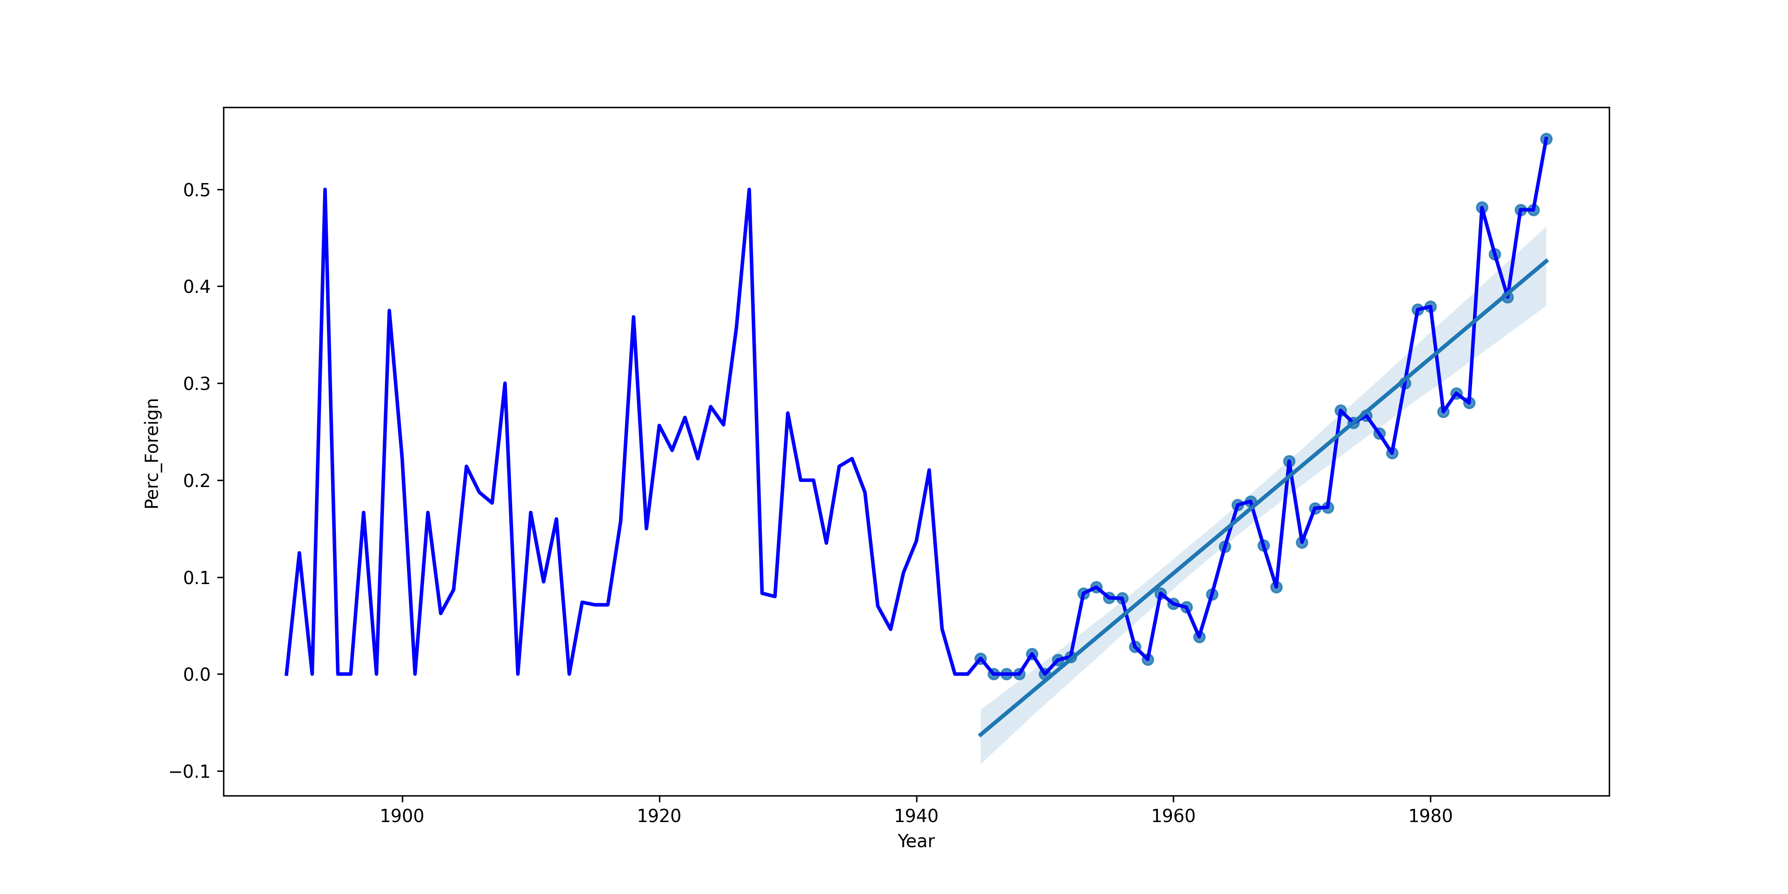
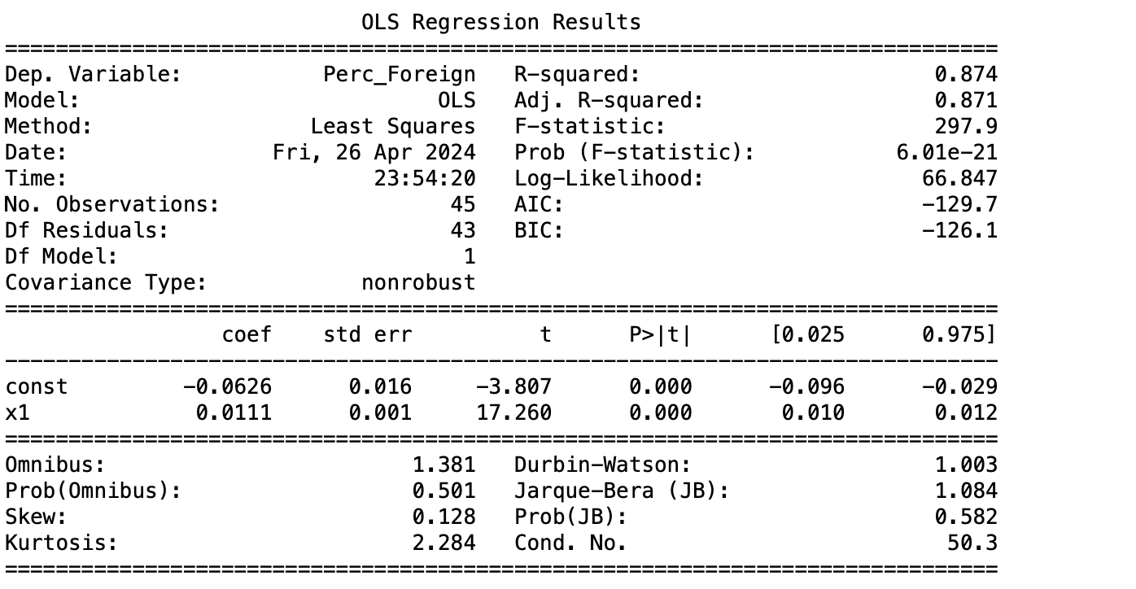
The Football Business
Natural Nearshoring
We can also perform a regression.
X: Player’s Year of birth
Y: Percentage of foreign players in the league
Every following year of birth the proportion of Foreign Players in Serie A increases by 1.1%.

Slide 15
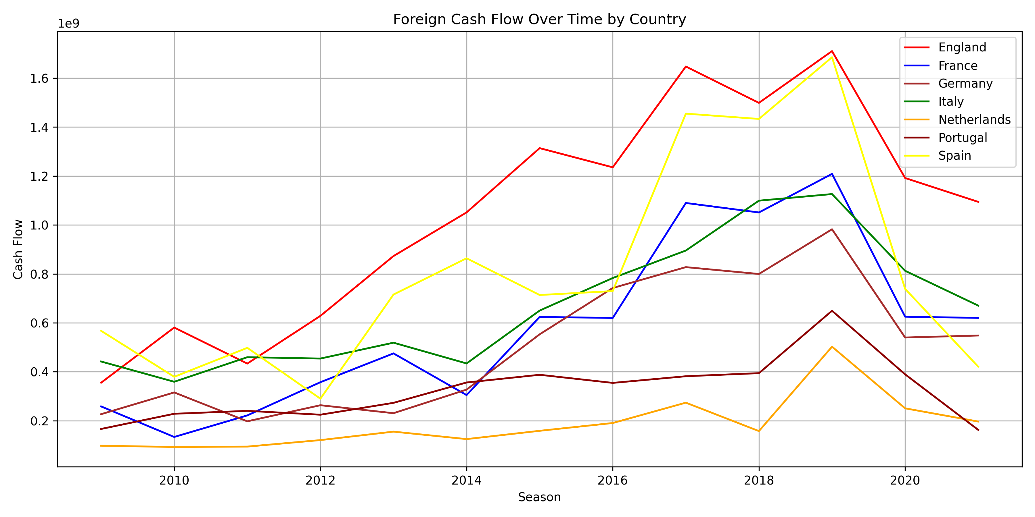
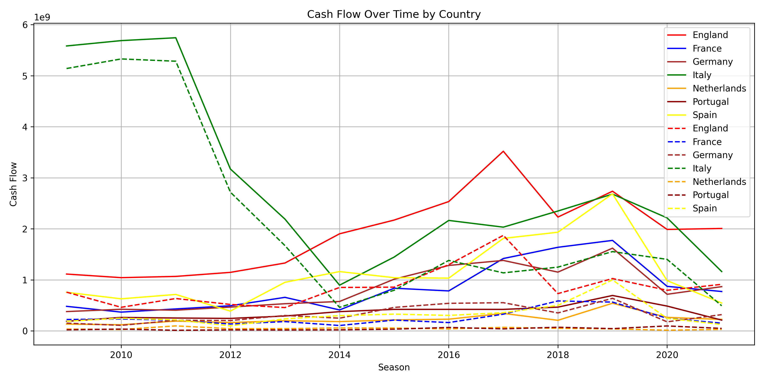
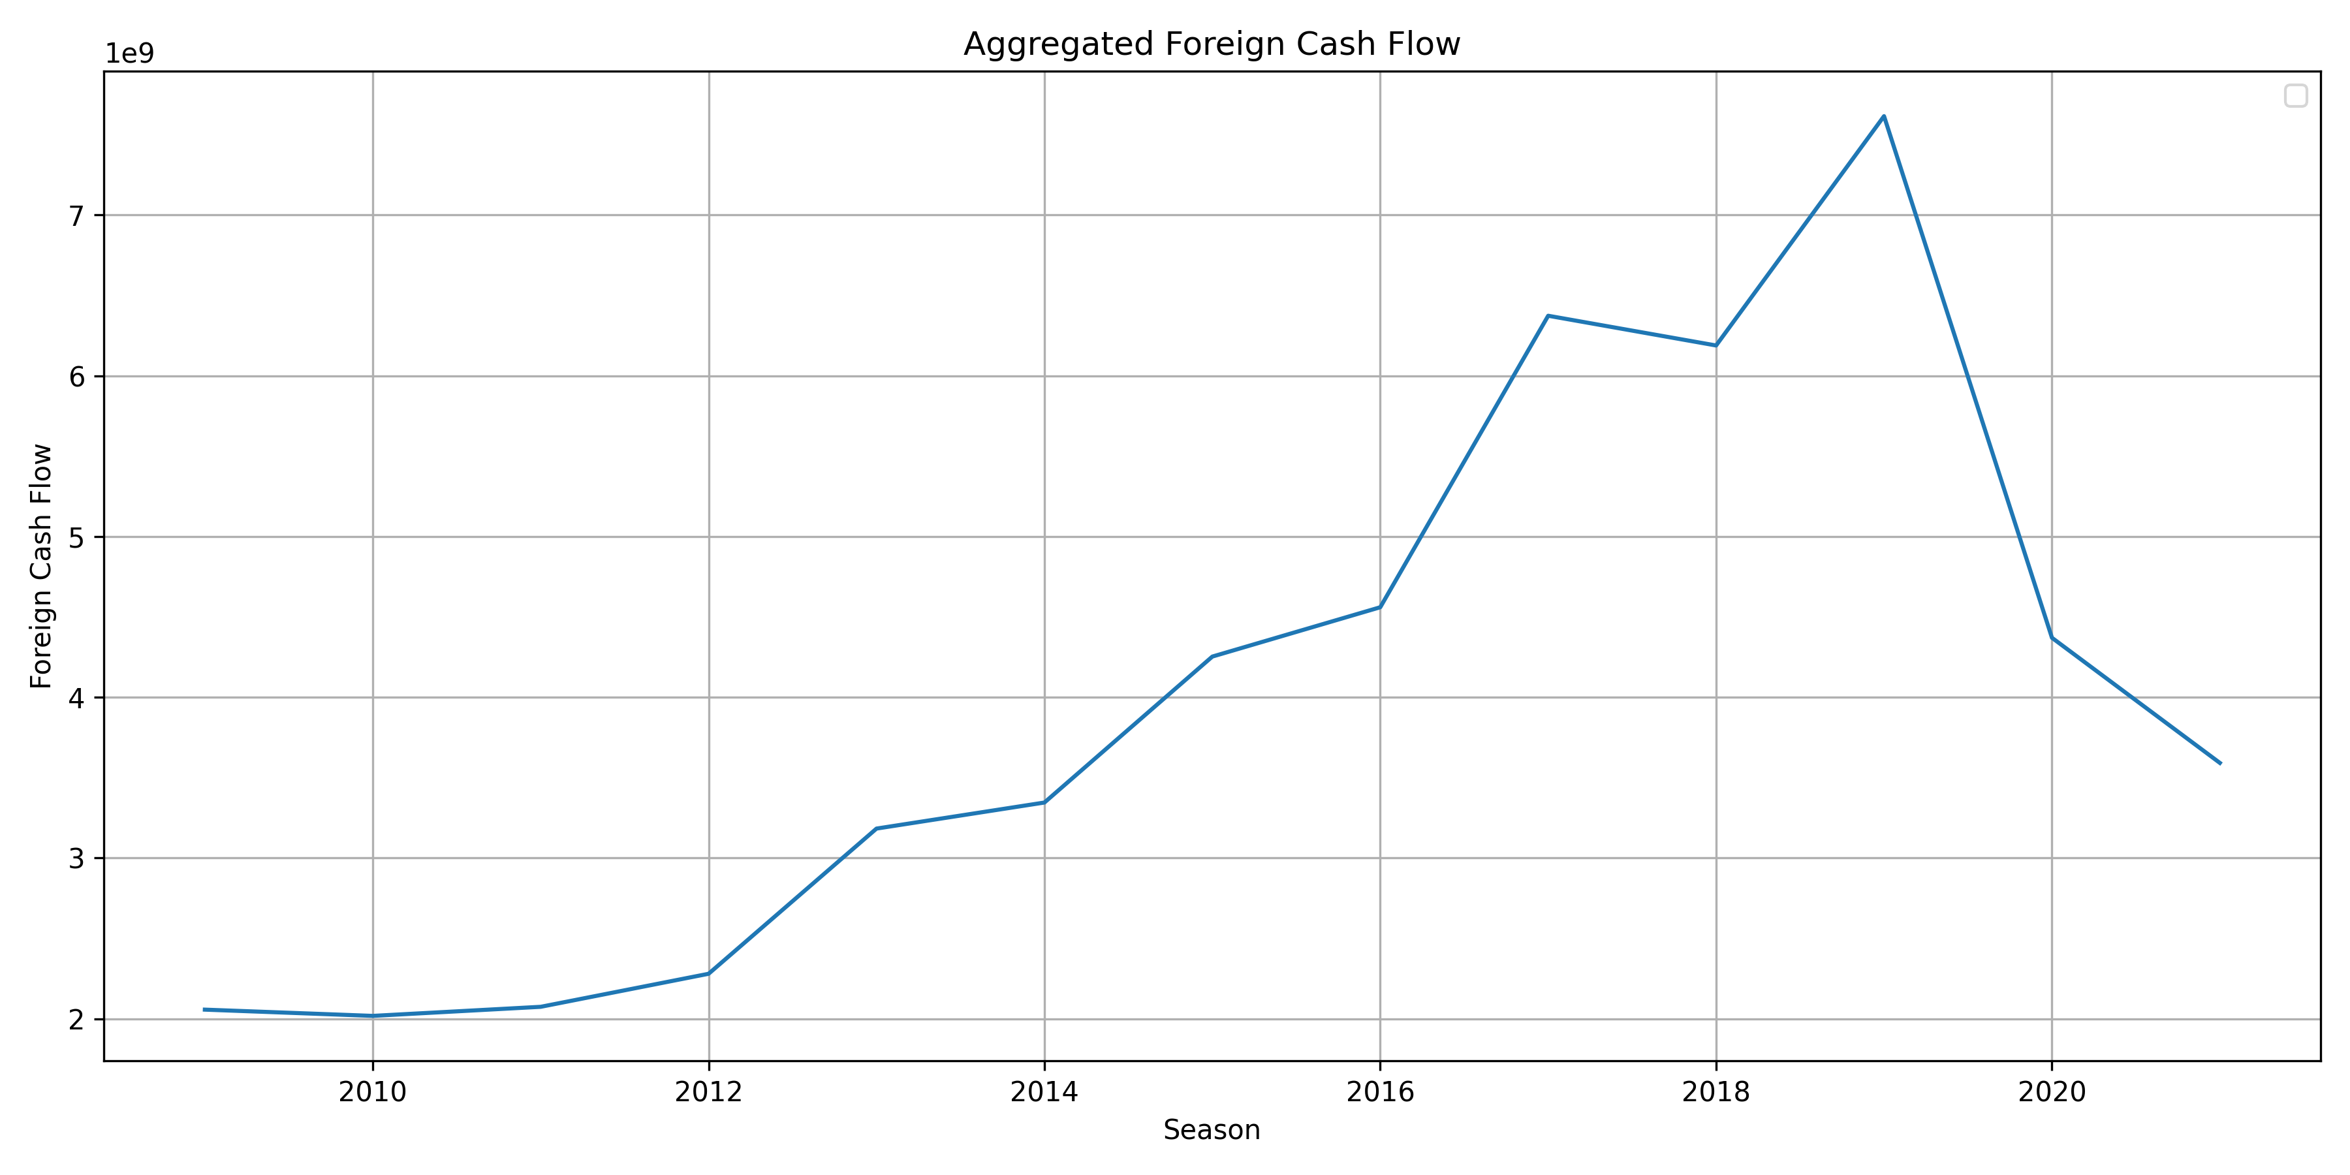
The Football Business
Foreign and Domestic Cash Flow
CASH FLOW ANALYSIS
The Data used is the Dataset of the Transactions from 2009 to 2021 in the Top 7 leagues in Europe
------ Foreign Cash Flow
------ Total Cash Flow
- - - - Domestic Cash Flow
Average total yearly cash flows: $4 bn

Slide 16
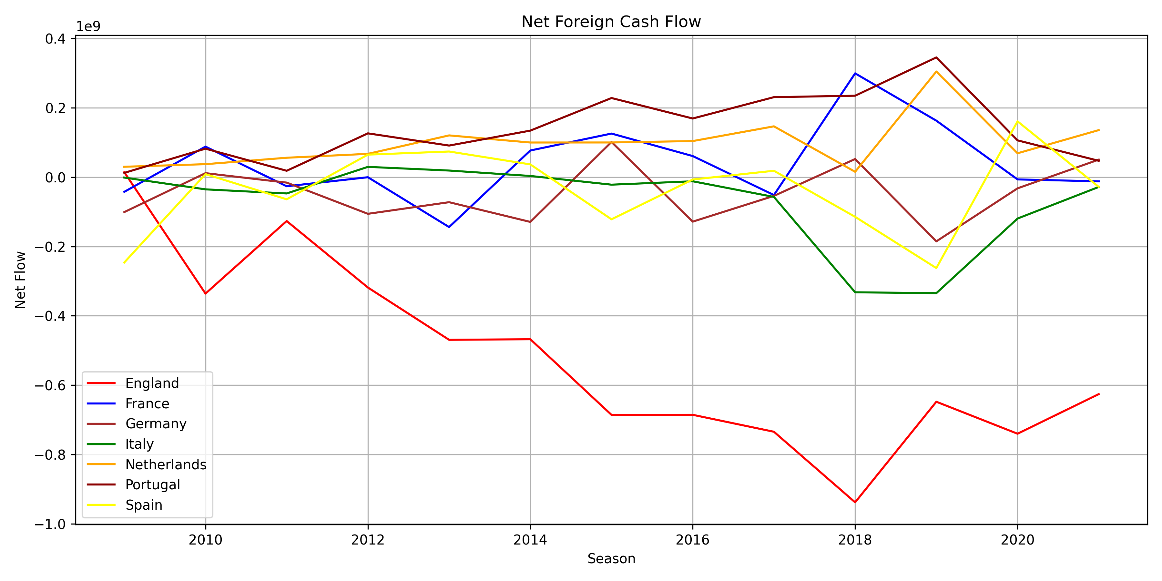
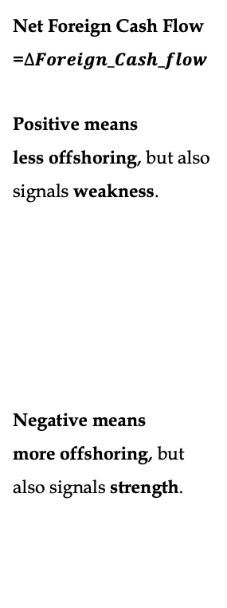
The Football Business
Net Foreign Cash Flow
Net Foreign Cash Flow =$∆Foreign_Cash_flow$
Positive means
less offshoring, but also signals weakness.
Negative means
more offshoring, but also signals strength.
Loss of Assets
Loss of Attractiveness
Loss of Competitivity

Slide 17
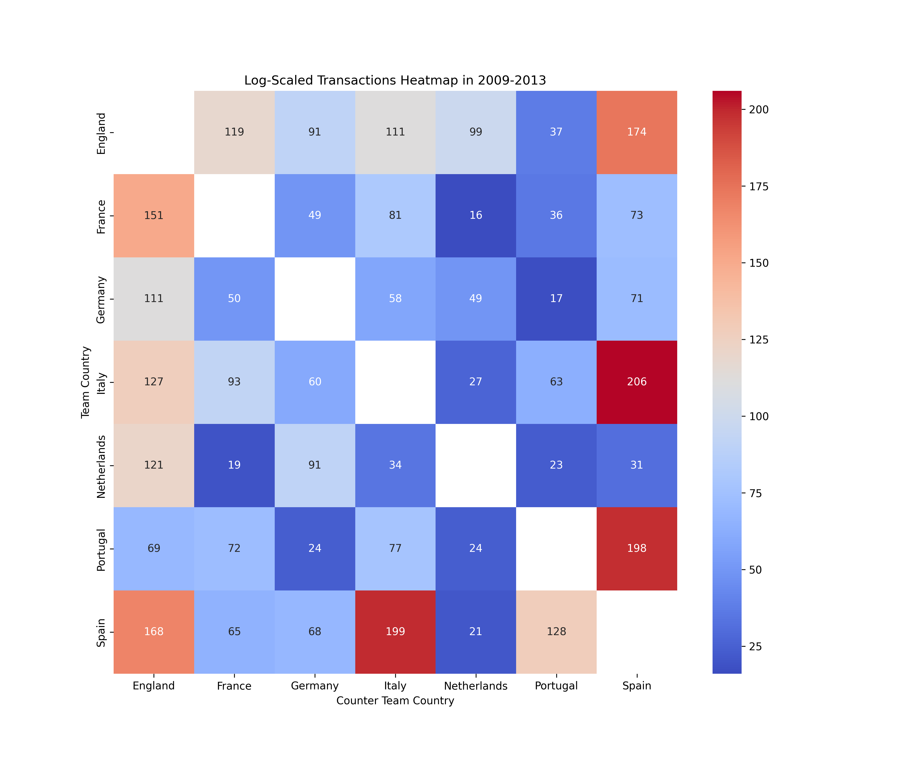
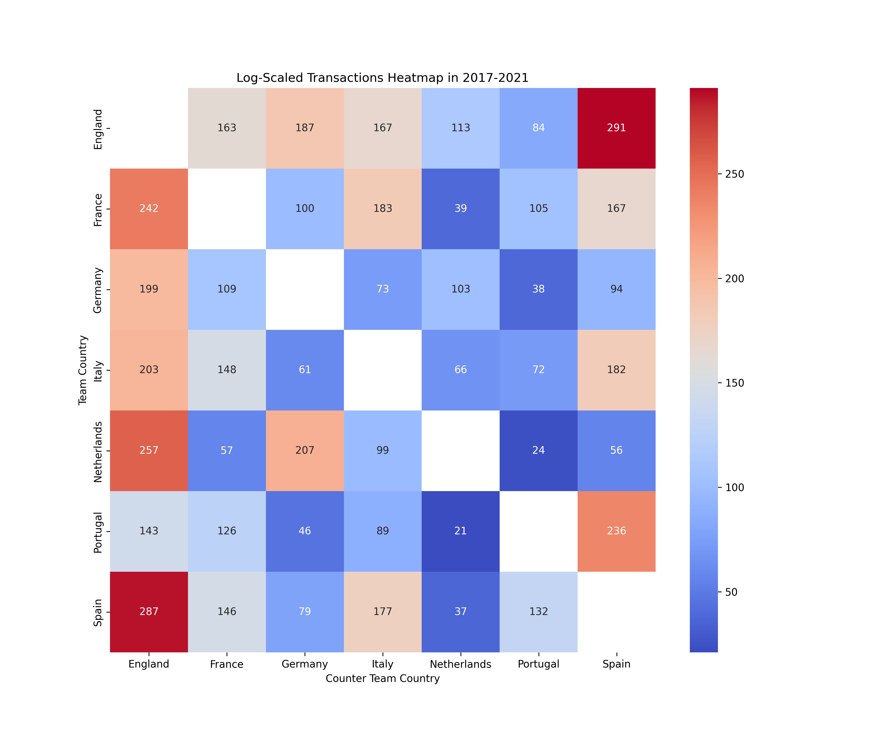
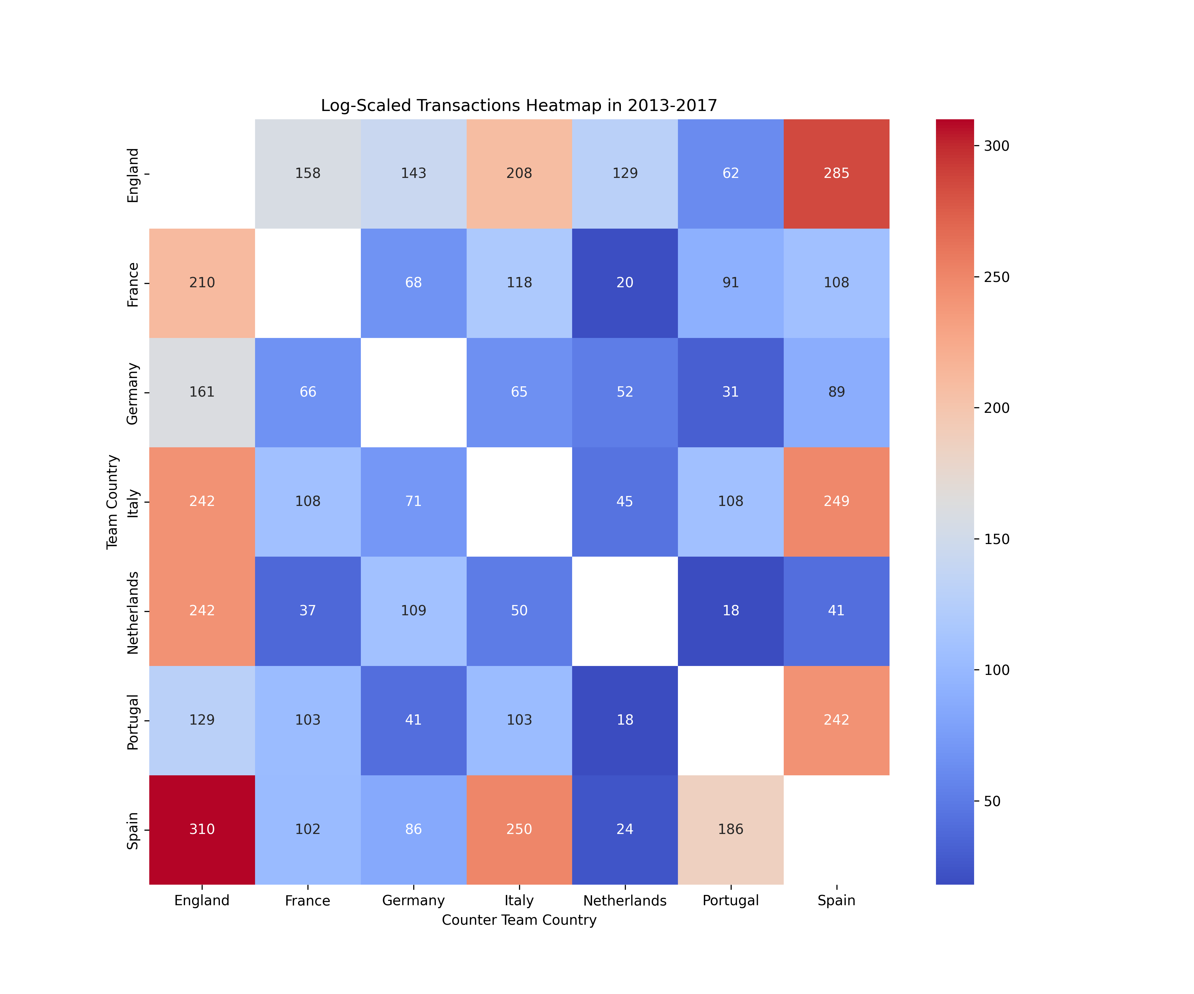
The Football Business
Which are the biggest Partners for each country?
This heatmap shows, in three different year ranges, how many transactions were performed between clubs of different leauges.
- Each cell box represents transactions from a country in the left column to a country in the bottom line.
Read row-wise, each row represents how many foreign purchases are made by a country.
- Read column-wise, each row represents how many players are bought from a country (Attractiveness & Level of the league).

Slide 18
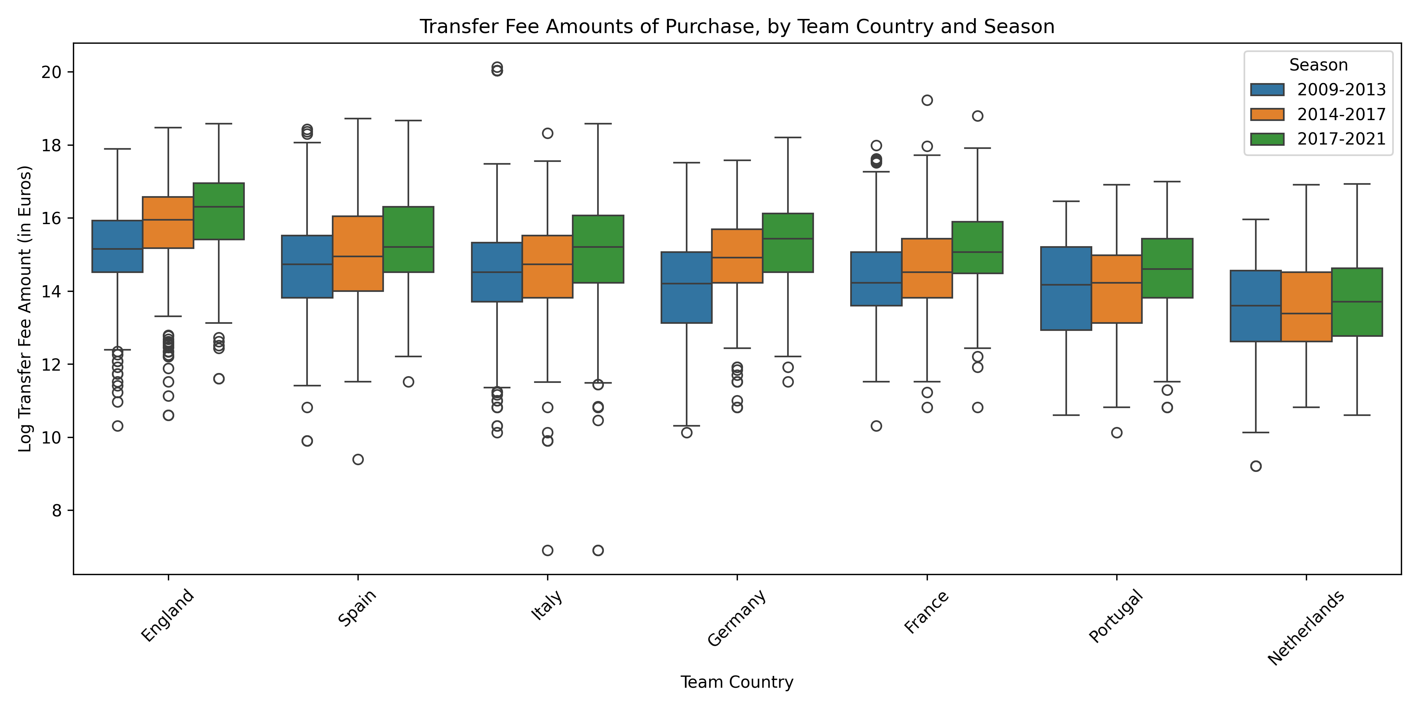
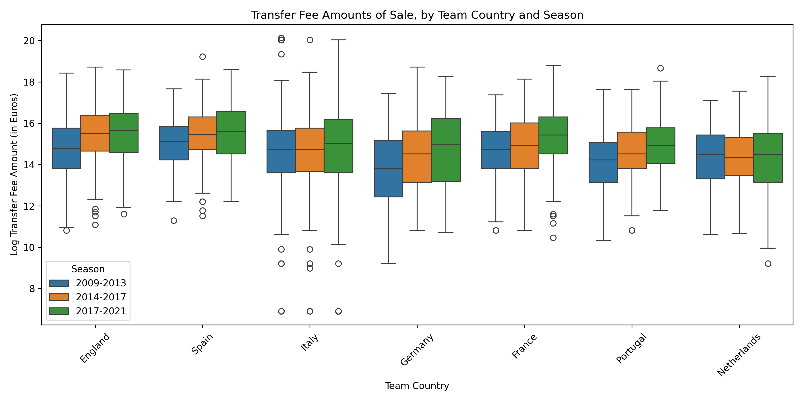
The Football Business
Expanding on league’s Attactiveness
Relative Bargaining Power
Growth signals richness
It indicates that the growth allows suppliers to ask for more

Slide 19
The Football Business
Expanding on league’s Attactiveness
Relative Bargaining Power
Growth signals higher value players leaving the League
Can also be useful to visualize the quality of the league

Slide 20
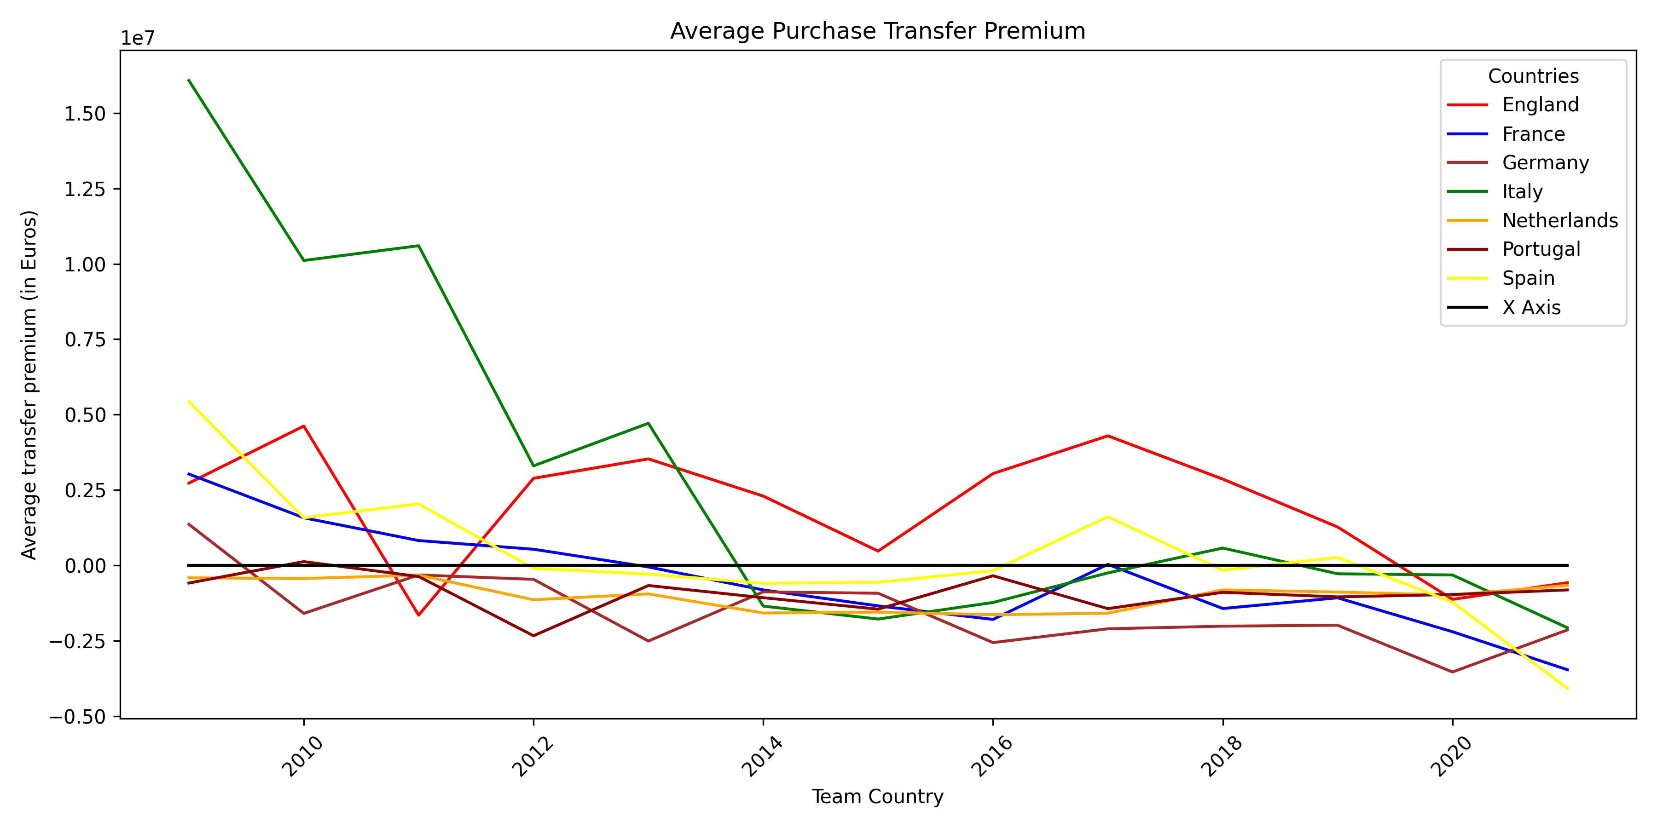
The Football Business
Transfer Premium
Acquisition Case:
When purchasing a player, ideally, you would like to pay as cheaply as possible, hence minimizing the
transfer premium.
Transfer Premium:
Transfer Fee - Market Value

Slide 21
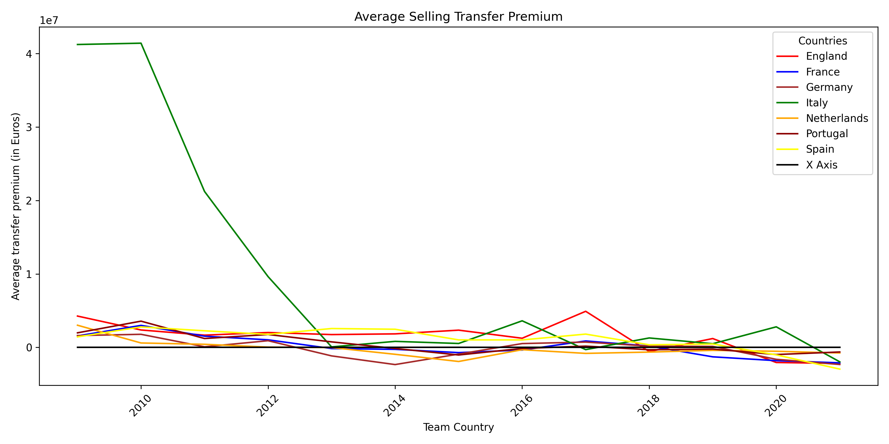
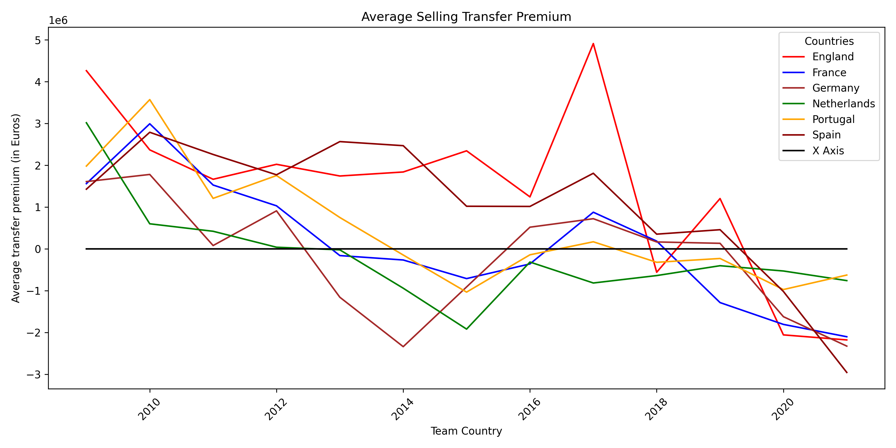
The Football Business
Transfer Premium
Transfer Premium:
Transfer Fee - Market Value
Transfer Premium:
Transfer Fee - Market Value
Sale Case:
When selling a player, ideally, you would like to get paid as much as possible, hence maximizing the
transfer premium.

Slide 22
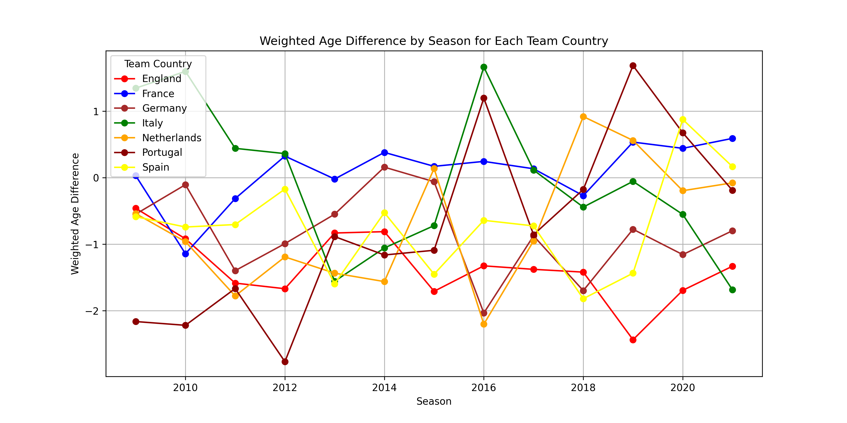
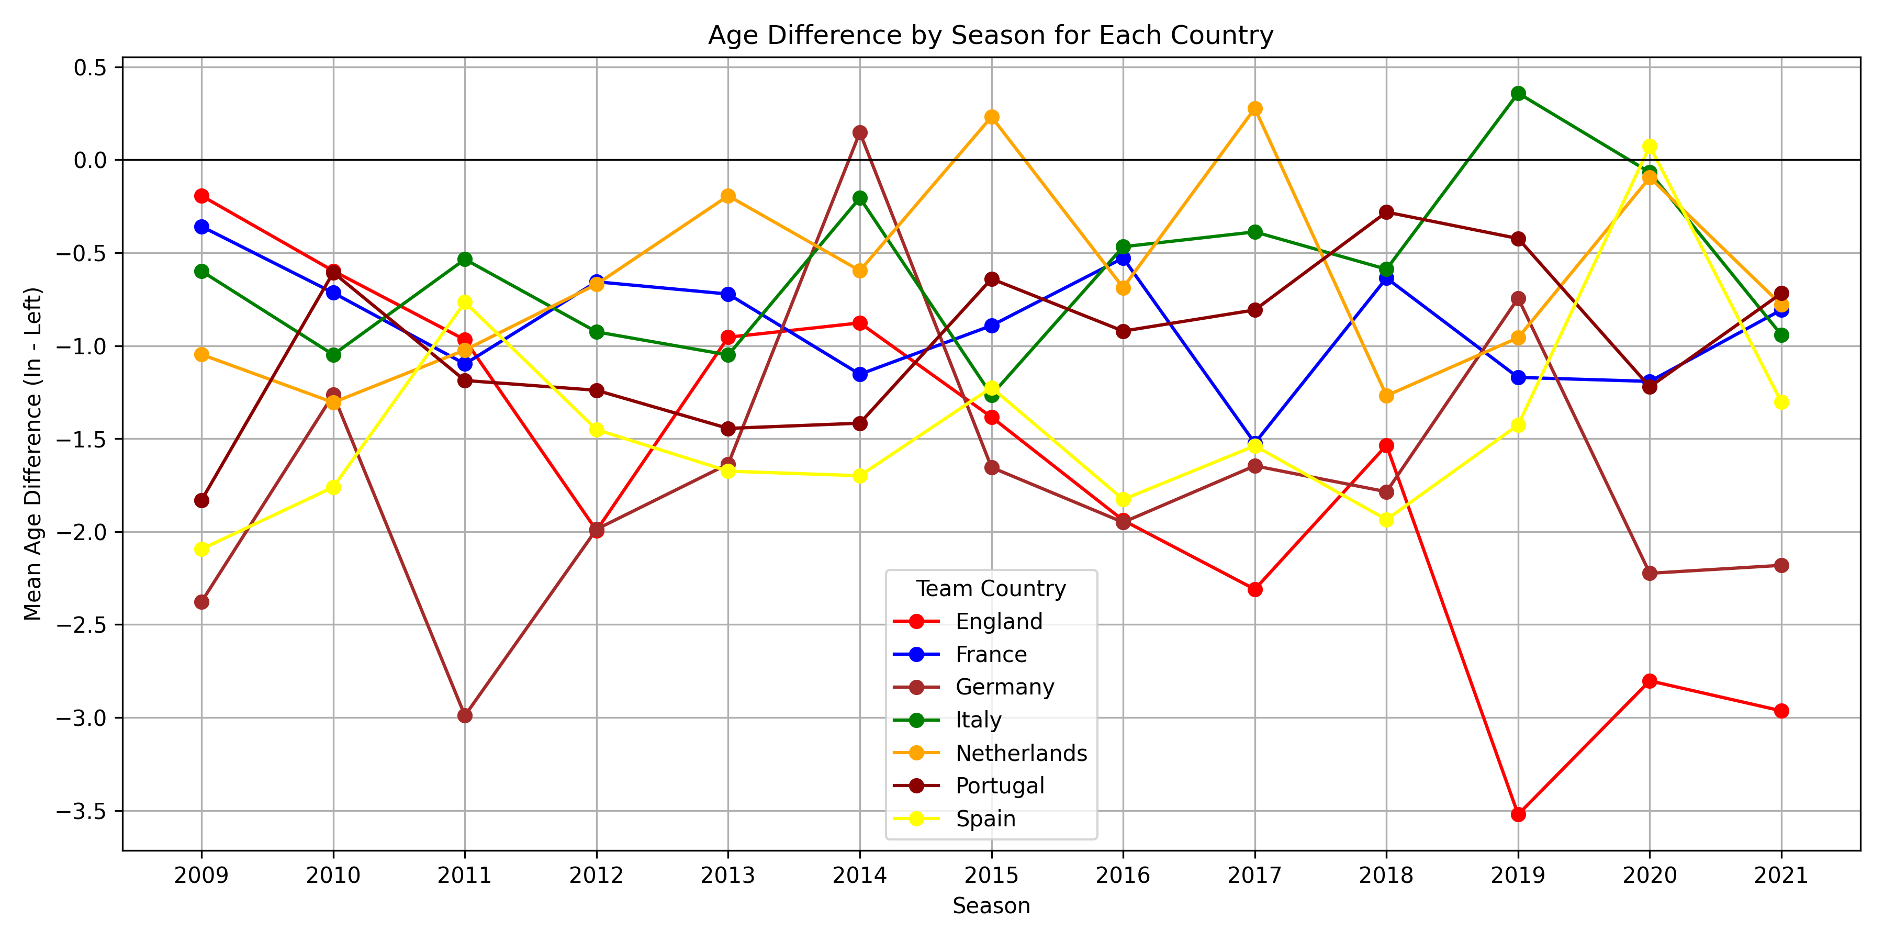
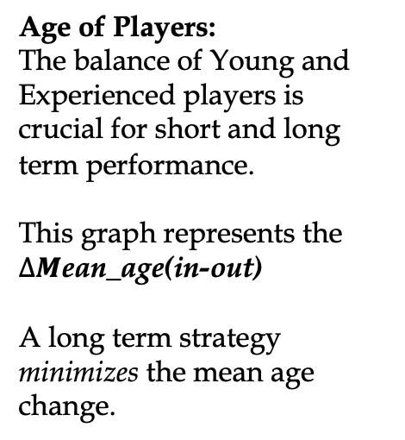
The Football Business
Age of players
Age of Players:
The balance of Young and Experienced players is crucial for short and long term performance.
This graph represents the $ΔM$ean_age(in-out)
A long term strategy minimizes the mean age change.
Weighted Average to see the strategy by taking into account players value

Slide 23
The Football Business
The catalyst effect of COVID-19 on the Relational Governace

Slide 24
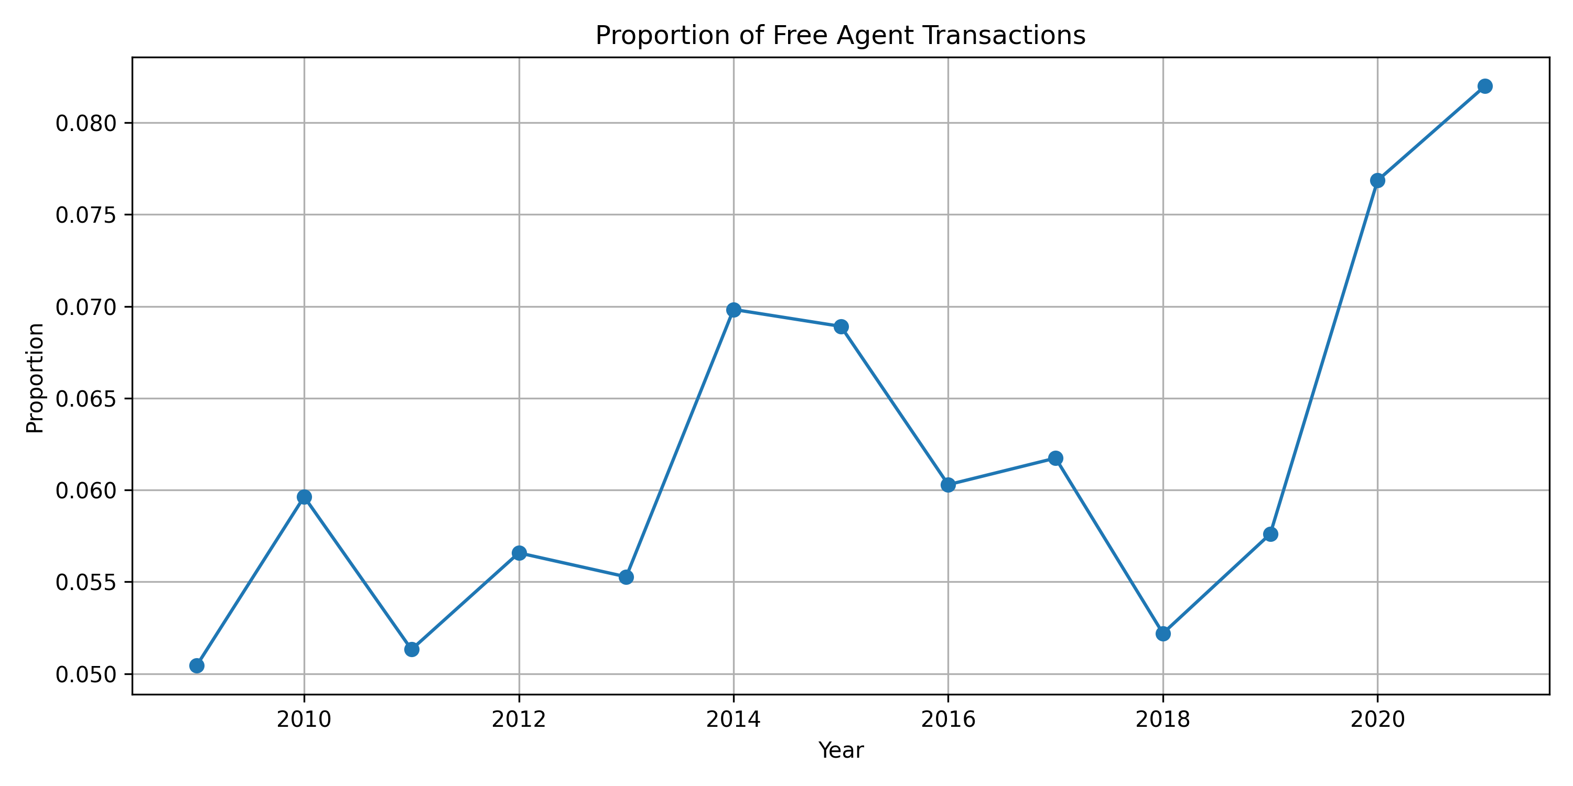
The Football Business
The catalyst effect of COVID-19 on the Relational Governace
Trade Shock :
Scarcity of Liquidity
Hyper-inflated prices
Opportunity:
Both Clubs and Agents are better off waiting for the expiration of the target player’s contract.
Exit Barrier:
External Supporters Pressure and Reputation

Slide 25
The Football Business
Conclusion
Is the “natural nearshoring” increasing or decreasing over-time?
Evidence suggests that nearshoring is increasing for Nationality, but after COVID-19 the trend inverted, hence Clubs are investing more on Local Players and their Academy
different countries?
2) What is the relationship between the leagues of different countries?
Clubs interact with Players through their Agents and, if present, their current Club. By analyzing several metrics, we could understand how much Leagues rely on foreign transactions, which are their main partners, the growth of the Fees, and their relative League premium.
What were the effects of COVID–19?
The Player’s market suffered a general decline, fees and transfer premiums plunged after the soaring increases of the 2010s. We have also analysed the change GVC governance, as more Clubs are adopting more sustainable strategies, visible in the growth of Free Agents transactions.

Slide 26
The Football Business
Thank You!
Group A
Emanuele Sebastianelli – 279711 – e.sebastianelli@student.luiss.it
Firas Tareg E Abuzakhar – 281711 – firas.abuzakhar@studenti.luiss.it
Giada Meucci - 284791 – giada.meucci@student.luiss.it
Ugo Barbato - 285531 – ugo.barbato@student.luiss.it
Bibliography
UEFA and Football Governance - A new model, Kevin Tallec Marston

